Slide 1
1-D Arrays
Searching and Sorting Techniques

Slide 2
Objectives
Understanding of
Searching Techniques
Linear Search
Binary Search
Sorting Techniques
Bubble Sort
Selection Sort

Slide 3
Searching & Sorting
Searching refers to finding whether a data item is present in the set of items or not.
Sorting refers to the arrangement of data in a particular order.
Sorting and searching have many applications in the area of computers.

Slide 4
Linear search
The Linear Search is applied on the set of items that are
not arranged in any particular order.
In linear search , the searching process starts from the
first item.
The searching is continued till either the item is found or
the end of the list is reached indicating that the item is
not found.

Slide 5
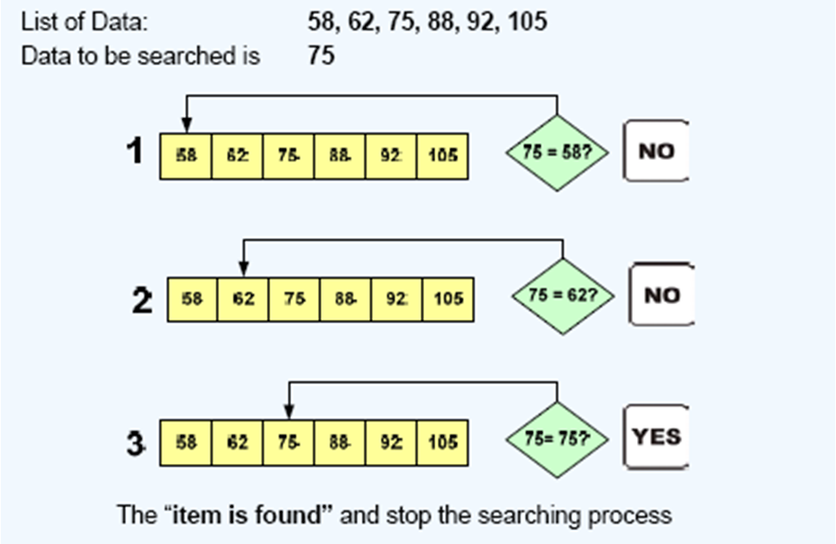
Linear search- Example 1

Slide 6
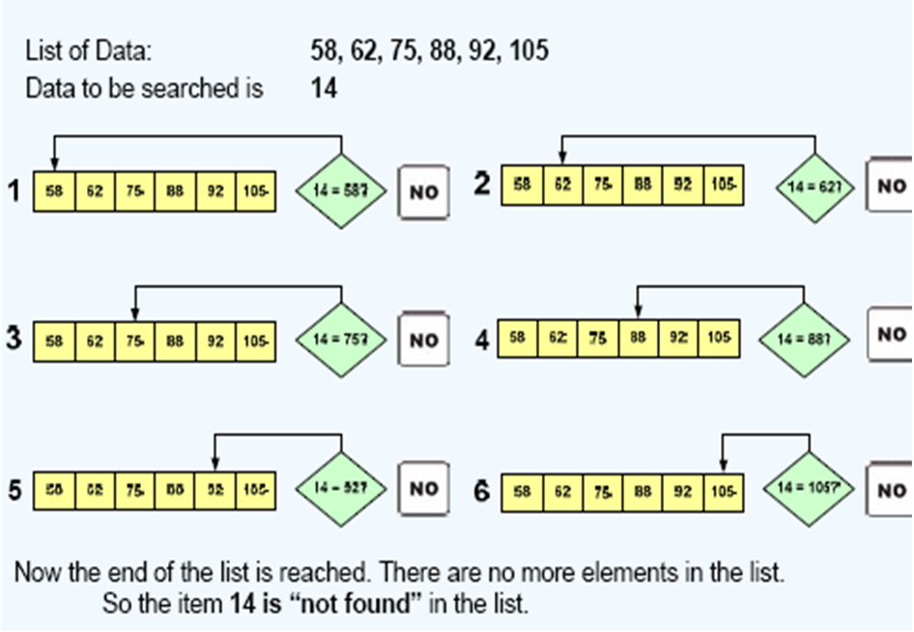
Linear search- Example-2

Slide 7
WAP to search an element in an array using linear search
for(i=0; i<n; i++)
{
if(a[i]==key)
{
found=1;
break;
}
}
if(found==1)
cout<<“Element is found ;
else
cout<<“Element is not
found“;
}
void main()
{
int a[100],i,n,key,found=0;
cout<<"enter no of elements";
cin>>n;
for(i=0;i<n;i++)
cin>>a[i];
cout<<"enter the element to be searched";
cin>>key;

Slide 8
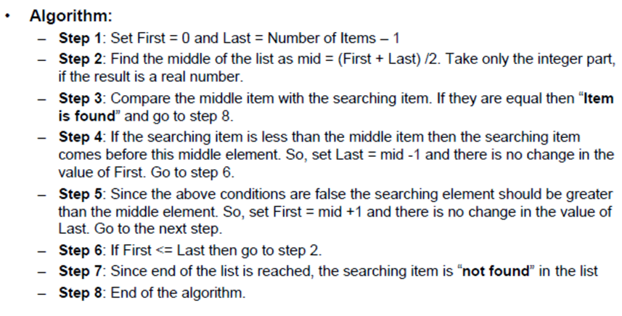
Binary Search
A binary search is a searching technique that can be applied only
to sorted list of items.
Notes:
Binary Search:
Binary search relies on a divide and conquer strategy to find a value within an already-sorted collection. Binary search requires a sorted collection. This means the collection must either be sorted before searching, or inserts/updates must be smart. Also, binary searching can only be applied to a collection that allows random access . The only time binary searching doesn't make sense is when the collection is being frequently updated, since re-sorting will be required.

Slide 9
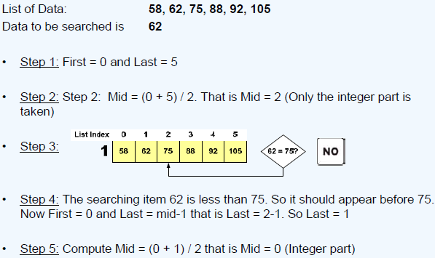
Binary Search – example-1

Slide 10
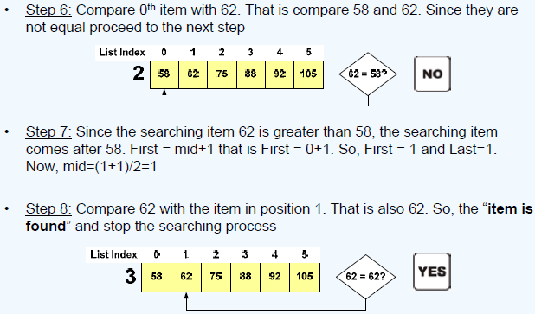
Binary Search – example-1

Slide 11
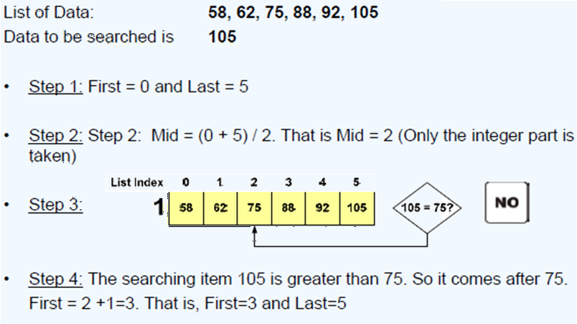
Binary Search – example-2

Slide 12
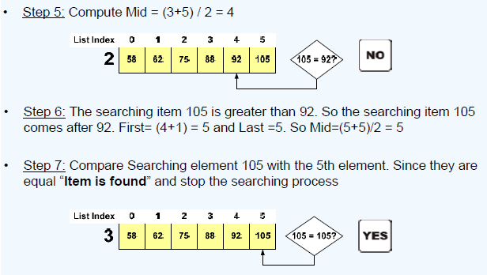
Binary Search – example-2

Slide 13
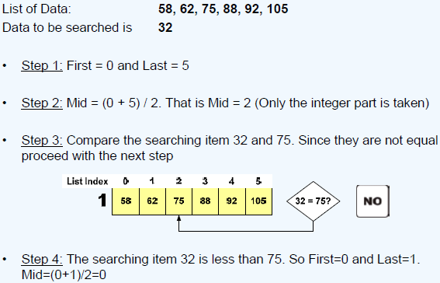
Binary Search – example-3

Slide 14
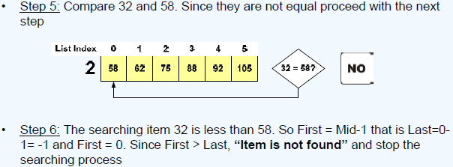
Binary Search – example-3

Slide 15
To search for a given number in an array using Binary Search method
while( low <= high)
{
mid= (low + high) / 2;
if (key == a[mid])
{
found = 1;
break;
}
else if ( key < a[mid] )
high = mid - 1;
else
low = mid + 1;
}
if( found == 1)
cout<<"SUCCESSFUL
SEARCH\n";
else
cout<<"Search is FAILED\n";
}
}
int main()
{
int a[10],i,n,low,high,mid,found,key;
cout<<"Enter no of elements\n";
cin>>n;
cout<<"Enter array elements in sorted order\n";
for(i=0;i<n;i++)
cin>>a[i];
cout<<"The elements of array are:\n";
for(i=0;i<n;i++)
cout<<a[i]<<"\t";
cout<<"\nEnter key to be searched\n";
cin>>key;
/* Binary search on sorted array */
found = 0;
low=0;
high=n-1;

Slide 16
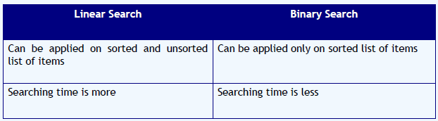
Linear versus Binary Search
Syntax
Additional Information
Animation
Do’s
Don’ts
Control Flow
Case studies
Do it yourself
Notes:
A linear search is the most basic of search algorithm you can have. A linear search sequentially moves through your collection (or data structure) looking for a matching value Linear searches don't require the collection to be sorted.
Searching is an important function in computer science. Many advanced algorithms and data structures have been devised for the sole purpose of making searches more efficient. And as the data sets become larger and larger, good search algorithms will become more important. At one point in the history of computing, sequential search was sufficient. But that quickly changed as the value of computers became apparent. Linear search has many interesting properties in its own right, but is also a basis for all other search algorithms. Binary search is the next logical step in searching. By dividing the working data set in half with each comparison.

Slide 17
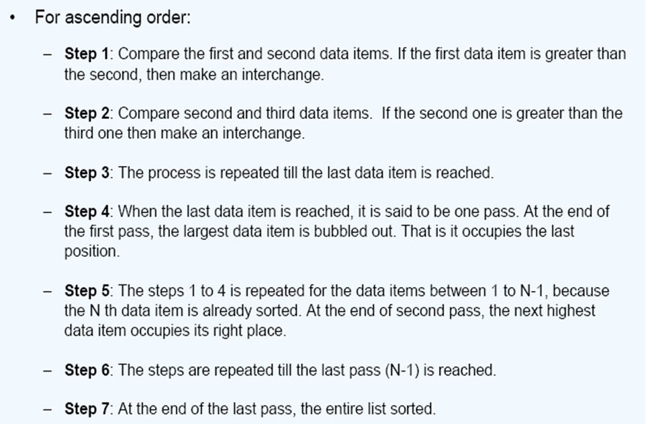
Bubble Sort Algorithm
Notes:
A sorted array is an array data structure in which each element is sorted in numerical, alphabetical, or some other order, and placed at equally spaced addresses in computer memory. It is typically used in computer science to implement static lookup tables to hold multiple values which have the same data type. Sorting an array is useful in organizing data in ordered form and recovering them rapidly.

Slide 18
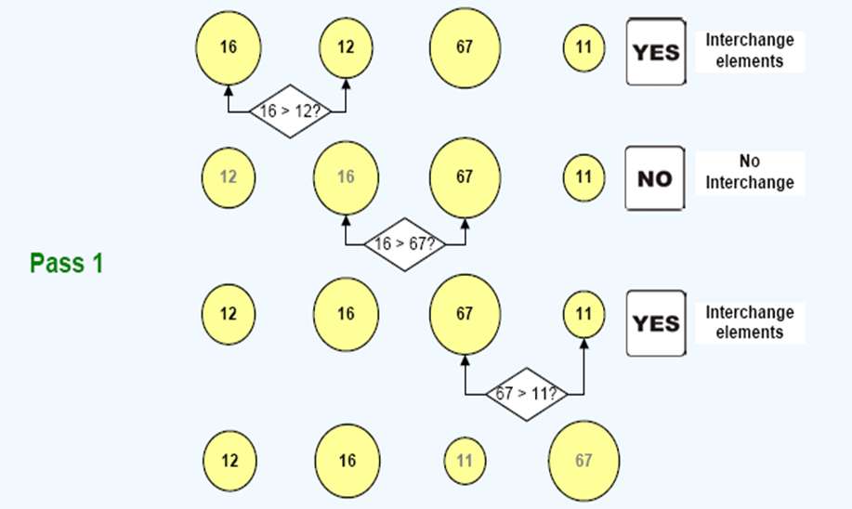
Bubble Sort- Example

Slide 19
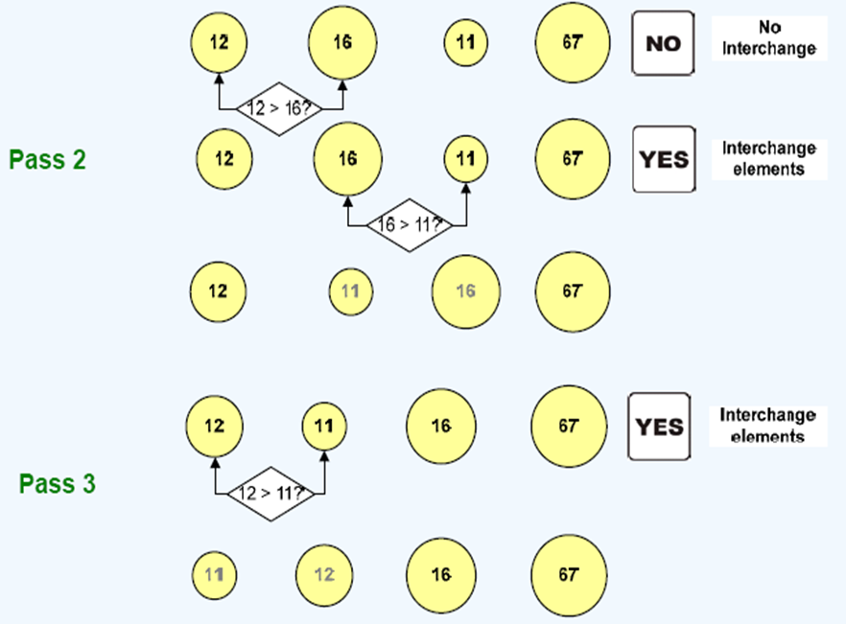
Bubble Sort- Example

Slide 20
To arrange the array elements in ascending/descending order using Bubble sort
for(i=0;i<n-1;i++)
{
for(j=0;j<n-i-1;j++)
{
if(a[j]>a[j+1]) // a[j]<a[j+1]
{
temp=a[j];
a[j]=a[j+1];
a[j+1]=temp;
}
}
}
cout<<"\nThe elements of array after sorting are:\n";
for(i=0;i<n;i++)
cout<<a[i]<<"\t";
}
int main()
{
int a[10],i,j,temp,n;
cout<<"Enter no of elements\n";
cin>>n;
cout<<"Enter array elements\n";
for(i=0;i<n;i++)
{
cin>>a[i];
}
cout<<"The elements of array are:\n";
for(i=0;i<n;i++)
cout<<a[i]<<"\t";

Slide 21
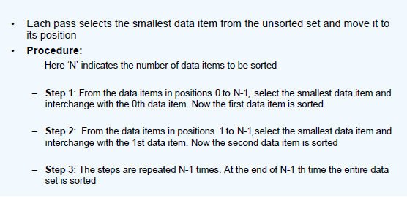
Selection Sort
Notes:
The aim of sorting algorithms is to put unordered information in an ordered form. There are many sorting algorithms, such as: - Selection Sort - Bubble Sort - Insertion Sort - Merge Sort and - Quick Sort. The first three are the foundations for faster and more efficient algorithms.

Slide 22
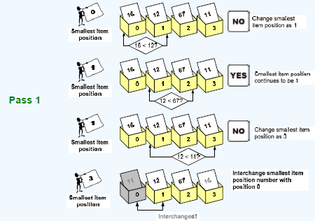
Selection Sort – example

Slide 23
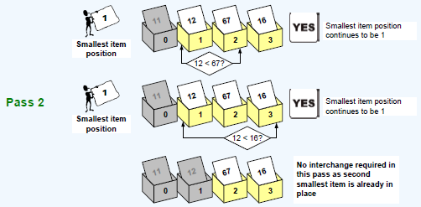
Selection Sort – example

Slide 24
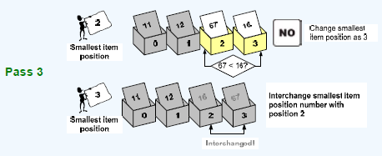
Selection Sort – example

Slide 25
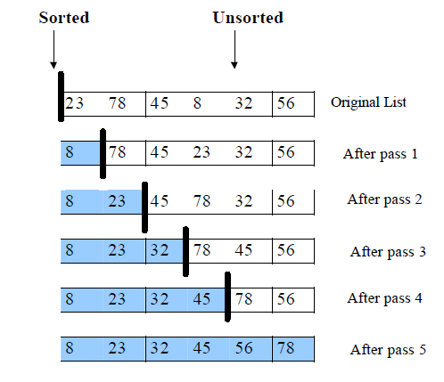
Selection Sort - Example
Notes:
Selection Sort:
We find the smallest element from the unsorted sublist and swap it with the element at the beginning of the unsorted data.
After each selection and swapping, the imaginary wall between the two sublists move one element ahead, increasing the number of sorted elements and decreasing the number of unsorted ones.
Each time we move one element from the unsorted sublist to the sorted sublist, we say that we have completed a sort pass.
A list of n elements requires n-1 passes to completely rearrange the data.

Slide 26
Selection Sort – program
for(i = 0; i < n-1; i++)
{
pos = i; small = a[i];
for(j=i+1; j<n; j++)
{
if(small > a[j])
{
pos = j;
small = a[j];
}
}
a[pos] = a[i];
a[i] = small;
}
cout<<"\nThe elements of array
after sorting are:\n";
for(i=0;i<n;i++)
cout<<a[i]<<"\t";
}
int main()
{
int a[10],i,j,pos,small,n;
cout<<"Enter no of elements\n";
cin>>n;
cout<<"Enter array elements\n";
for(i=0;i<n;i++)
cin>>a[i];
cout<<"The elements of array are:\n";
for(i=0;i<n;i++)
cout<<a[i]<<"\t";

Slide 27
Summary
Searching Techniques
Linear Search
Binary Search
Sorting Techniques
Bubble Sort
Selection Sort

